Slide 1
Creating A Legacy of Our Own
By Jordan Manlove

Slide 2
Outline
Purpose
Legacy
Methods
  used for gathering information
Topics
  Summary of summer
  Project flow
  Attire
  Meetings
Acknowledgments

Slide 3


Purpose
To create an intern guidebook to allow for smoother transition into Summer Internship

Slide 4

Project Explanation
An intern guidebook
  Summary of Summer
  Project Explanation
  Assignments
  Attire
  Meetings

Slide 5

Guidebook : Methods
Research of similar books online
  Guideline Book
  School Policy Guidebooks
  Interviewed Other Interns
    Gained Feedback from
    Added corrections

Slide 6

Methods: Continuation
Met with
  ECHO Team
    Formatted in LM style
    Discussed updates to page from communication standpoint
    Exchange of Ideas, Suggestions, and Implementations

Slide 7

Topics
Summary of Summer
Explanation of Projects
Appropriate Attire
  Office
  Lab
Meetings
  Company Meetings
  Intern/Mentor Intro Meetings

Slide 8
Summary Of Summer
Intern expectations down on paper
Interns are expected to:
  Complete all projects assigned to them by the associated due date
  Monitor, track, and record their hours of work completed
  Submit any requested documents related to the internship
  Meet weekly with mentors to give update on work (up to mentor’s discretion)
  Attend any/all meetings at request of mentor
  Give accompanying presentation with projects at end of internship
  Treat Internship with utmost seriousness, as well as bring a professional mindset

Slide 9
Research Project
Explanation of different project types
Report
Paper
Presentation
Subject to Change on year-to-year basis
Details : Aid in gaining better understanding
What
Who
Why

Slide 10
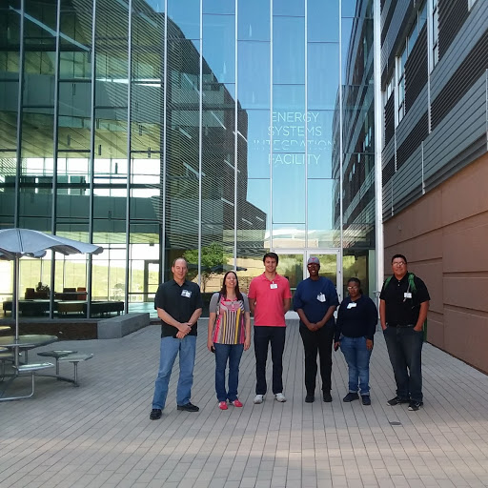
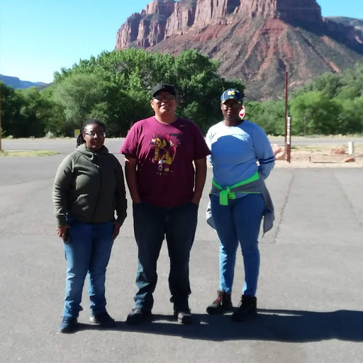
Attire
Field Attire
  Hiking Boots
  Hats
  Long sleeve shirt
  Breathable shirt
  Hiking pants
  Jeans
  Light jacket
Office Attire
Polo
Slacks
Khakis
Blouse
Skirts
Jeans

Slide 11
Meetings
Discusses meeting types
  LM 20.1
    Internal team meeting
  Technical Topics
    Open to LM, tech topics discussed
  All Hands
    Highly recommended to company
Summaries of each meeting, expectations
Ex :
  Team Meetings that help you learn about what company does
  Time : Every Tuesday @ 2PM MST

Slide 12
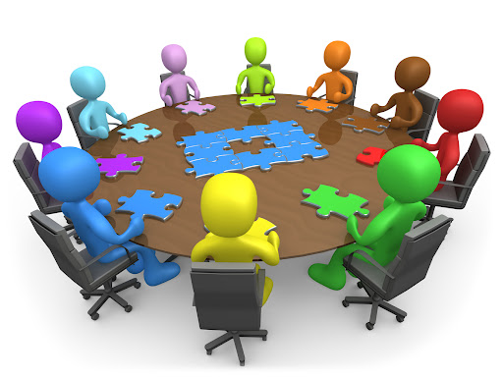
Collaborations/
Acknowledgments
Angelita Denny
Jennifer Harris – RSI PA
Erica Green – RSI PA
Interns
  Olivia Bustillo - FIU Student
  Eduardo Rojas – FIU Student
  Kayla Brown – MES Student

Slide 13

Takeaways
More Motivated
  Work from scratch
Professional Growth
Self Independent
  Learned how to do Independent work

Slide 14
References
https://info.parkerdewey.com/internship-hnadbook
https://ela.nmsu.edu/files/2016/02/Student-Internship-Handbook_Feb416.pdf
https://www.coeaerospace.com/wp-content/uploads/2016/12/Employer-Internship-Handbook.pdf

Slide 15
Thank You
Any Questions?

